Slide 1



How to guide -
Population in City and Hackney
28 July 2025

Slide 2
Contents
Quick start guide
Navigating the dashboard (jump to page specific instructions here)
Downloads
Sharing
Glossary
Troubleshooting

Slide 3

Quick Start Guide
Access the dashboard via this link: https://public.tableau.com/app/profile/phit.hackney/viz/PopulationHealthProfile/Populationhealthdashboard
Hover over the ‘What’s on this page?’ icon on the dashboard for information and instructions
Ask PHIT for help or share feedback: phit@hackney.gov.uk

Slide 4

Navigating the dashboard
Notes:
Need to say about downloading This Story

Slide 5
Dashboard pages
Population trends - filters
Population trends- visuals
Births, deaths, migration - filters
Births, deaths, migration - visuals
Ethnic mix - filters
Ethnic mix - visuals
Life and healthy life expectancy - filters
Life and healthy life expectancy - visuals
Further information

Slide 6
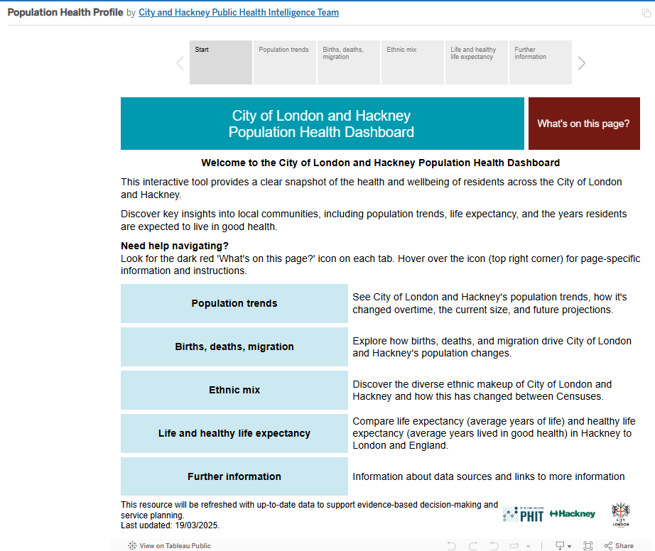
Start page
Click these grey boxes to move to the different pages
Click this link to view other PHIT dashboards
Hover over the ‘What’s on this page?’ icon - this is bring up a pop out box that explains each page
These light blue boxes correspond to the different dashboard pages and the grey boxes at the top of the page
Click the PHIT logo to be taken to the City and Hackney Public Health website

Slide 7
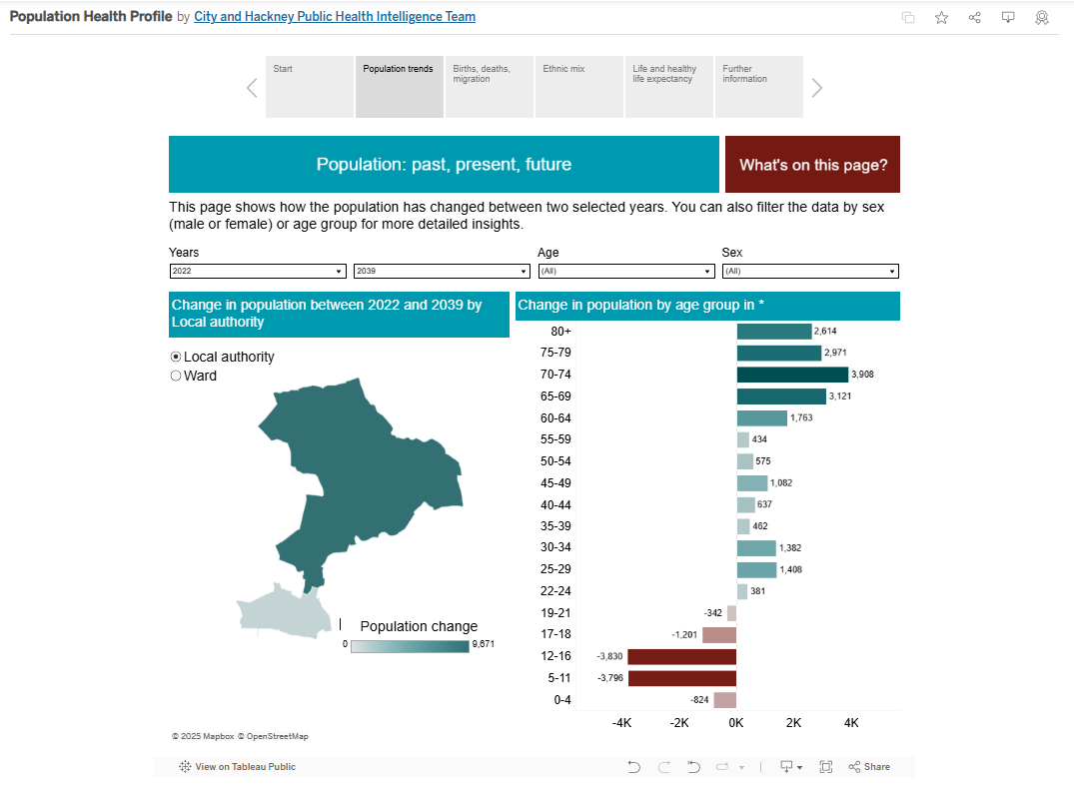
Population trends - Filters
Hover over the ‘What’s on this page?’ icon - this is bring up a pop out box that explains each page
Drop down box to change the years
Drop down box to change the sex (persons, female, male)
Select ward or local authority to change the map breakdown
Drop down box to change the age group
Select the ward/borough on the map you’re interested in to show data for this area

Slide 8
Population trends - visuals
Hover over the ‘What’s on this page?’ icon - this is bring up a pop out box that explains each page
Map shows change in the population (red indicates a decrease and blue indicators an increase)
Bar chart showing change in population by age group
Scale - the darker the shade the larger the change
Blue represents increase in population size
Red represents decrease in population size

Slide 9
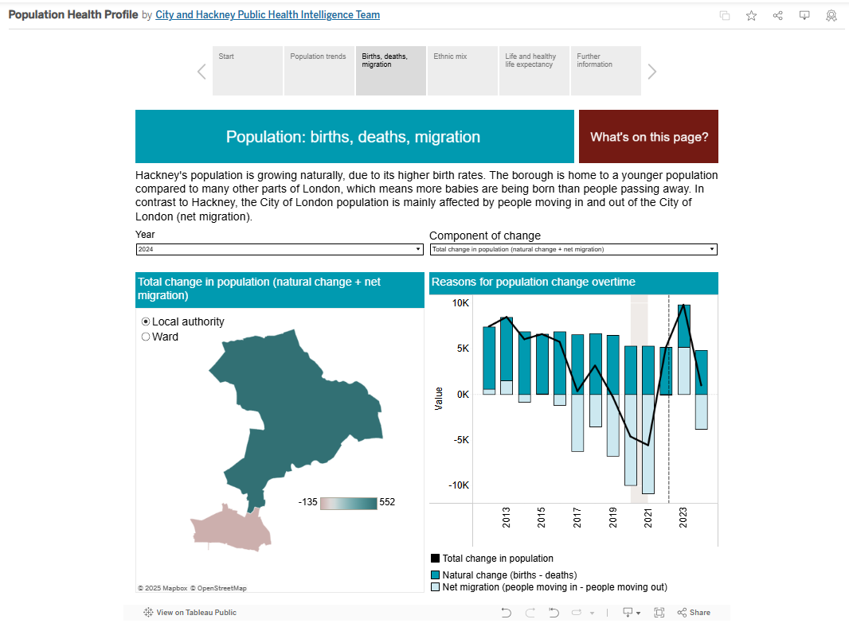
Births, deaths, migration - Filters
Hover over the ‘What’s on this page?’ icon - this is bring up a pop out box that explains each page
Drop down box to change the year
Drop down box to change the component of change
Select ward or local authority to change the map breakdown
Select the ward/local authority on the map you’re interested in to show data for this area

Slide 10
Births, deaths, migration- visuals
Hover over the ‘What’s on this page?’ icon - this is bring up a pop out box that explains each page
Map shows the component of change across wards/local authority
Bar chart shows the change in population split into natural change and net migration
Scale - the darker the shade the higher the value

Slide 11
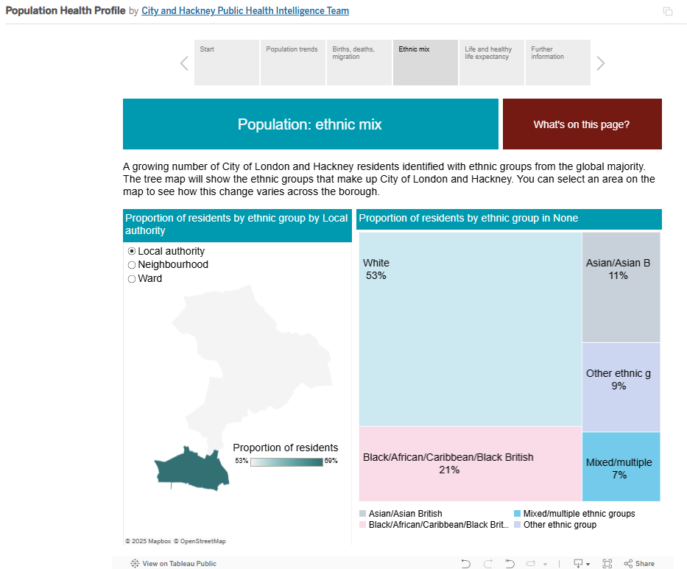
Ethnic mix- Filters
Hover over the ‘What’s on this page?’ icon - this is bring up a pop out box that explains each page
Select local authority, ward or neighbourhood to change the map breakdown
Select an ethnic group in the tree map so change the map
Select the local authority/ward/neighbourhood on the map you’re interested in to show data for this area

Slide 12
Health profiles by ethnicity - visuals
Hover over the ‘What’s on this page?’ icon - this is bring up a pop out box that explains each page
Bar chart shows proportion of each ethnic group in selected area (default in City and Hackney)
Map shows proportion of residents for selected ethnic group
Scale - the darker the shade the higher the proportion

Slide 13
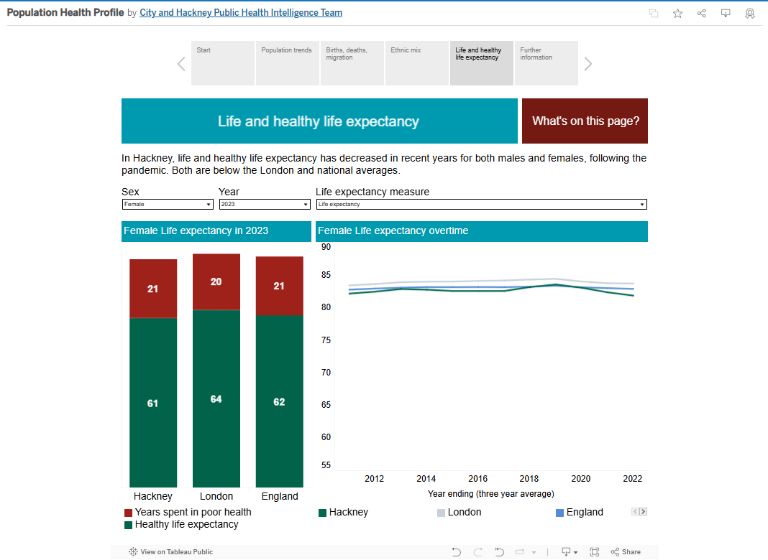
Life and healthy life expectancy - Filters
Hover over the ‘What’s on this page?’ icon - this is bring up a pop out box that explains each page
Use drop down filter to change between female and male for bar and line graph
Drop down box to change variable to life and healthy expectancy for line graph)
Drop down box to change year for bar chart

Slide 14
Life and healthy life expectancy - Visuals
Hover over the ‘What’s on this page?’ icon - this is bring up a pop out box that explains each page
Bar chart showing total life expectancy split into years spent in good and poor health for Hackney, London and England
Line graph showing life or healthy life expectancy overtime for Hackney, London and England

Slide 15
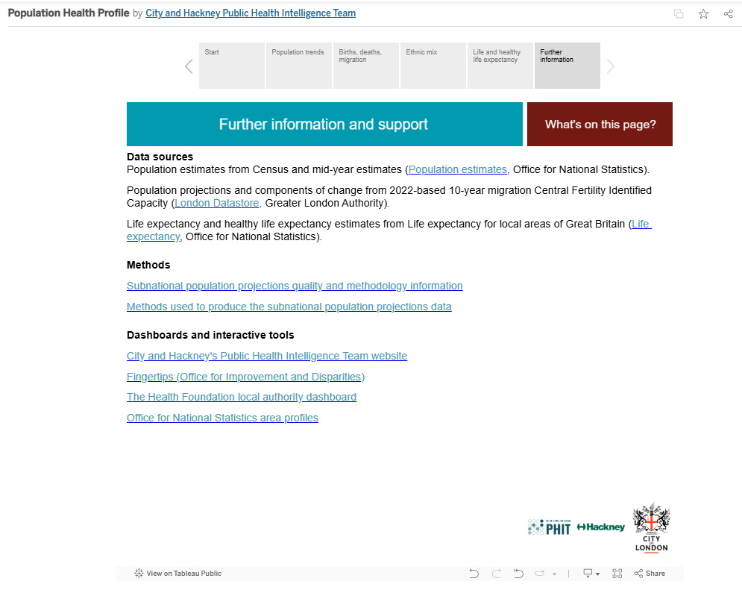
Further information
Hover over the ‘What’s on this page?’ icon - this is bring up a pop out box that explains each page
Information on data sources
Further resources for related data
Click the PHIT logo to be taken to the City and Hackney Public Health website

Slide 16
Downloads
Notes:
Need to say about downloading This Story

Slide 17
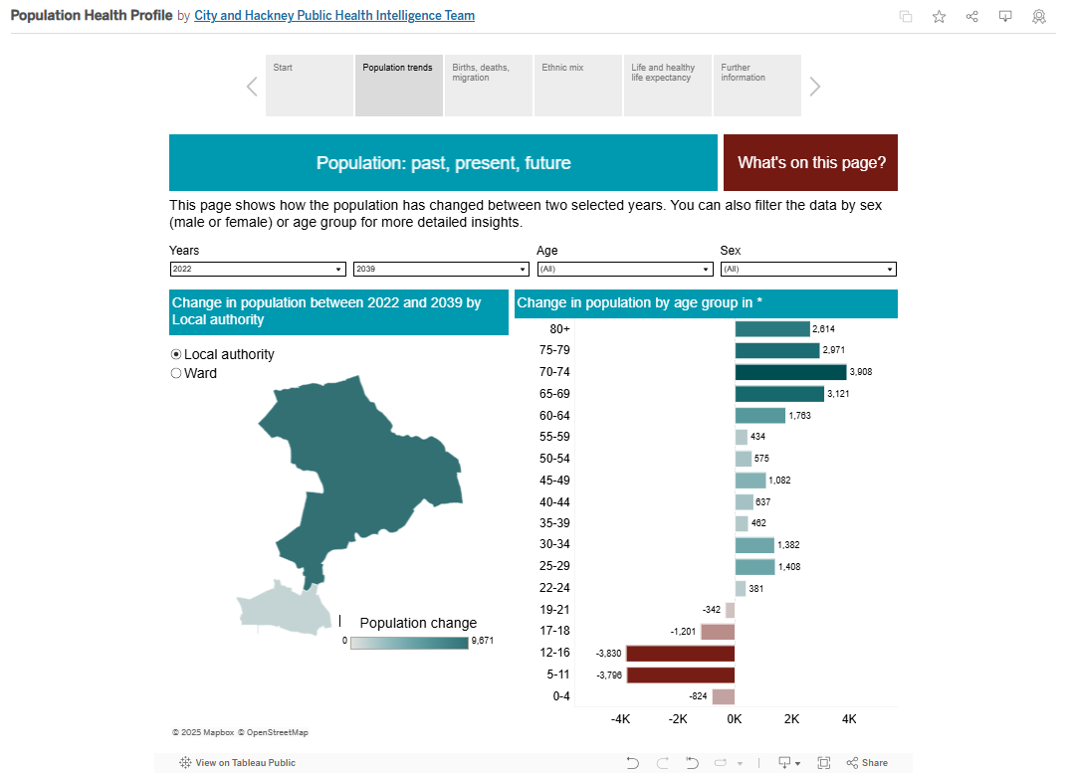
Downloads
You can download the dashboard page in the following formats:
Image (png)
Pdf
Powerpoint (ppt)

Slide 18

Downloads - step 1
Select the icon at the top right hand corner of the dashboard
Icon is a grey rectangle with an arrow pointing downwards
(see red circle in image for location)

Slide 19
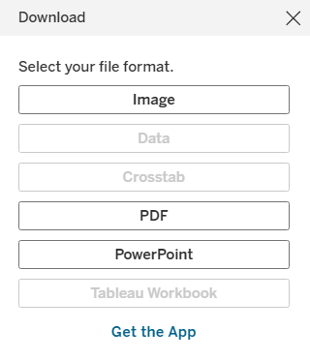
Downloads - step 2
A pop up box will appear in the middle of your screen (see image to the right)
Here you select the file format - see next slides for details on each option

Slide 20
Downloads - downloading an image
Selecting image will automatically download the dashboard page you’re viewing - this will appear in your downloads.
To do this, click the image button

Slide 21
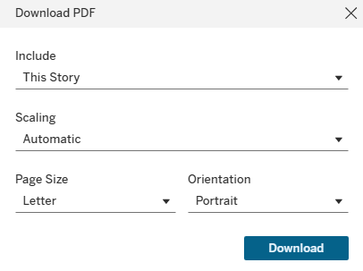
Downloads - downloading a PDF
Select PDF to download a PDF of the entire dashboard.
This will open a second pop up box.
Make sure the Include dropdown is always ‘This Story’.
Other fields can be changed but we recommend leaving these as the default options.
To download, click the blue download box

Slide 22
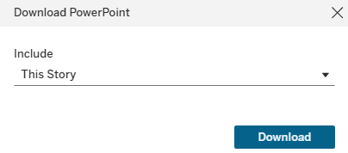
Downloads - downloading a powerpoint
Select PowerPoint to download a powerpoint (slide pack) of the entire dashboard.
This will open a second pop up box.
Make sure the Include dropdown is always ‘This Story’.
To download, click the blue download box

Slide 23
Sharing
Notes:
Need to say about downloading This Story

Slide 24

Sharing - step 1
Select the icon at the top right hand corner of the dashboard
Icon is three grey circles connected by grey lines
(see red circle in image for location)

Slide 25
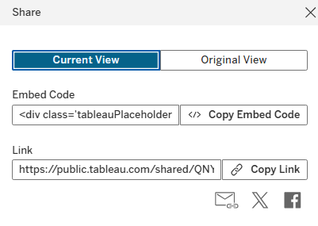
Sharing - step 2
A pop up box will appear in the middle of your screen (see image below)
Selecting Current View will share the dashboard in the state you’re viewing
Selecting Original View will share the dashboard in the default settings
Select Copy Link - you can then paste in emails/messages etc to share

Slide 26
Glossary
Notes:
Need to say about downloading This Story

Slide 27
Glossary - components of change (1)
Term | Definition
Births | Birth estimates for past years have been created by best-fit by the GLA from available published Office for National Statistics data for LSOA and Output Areas. Birth statistics are derived from information recorded when live births and stillbirths are registered as part of civil registration, a legal requirement; these data represent the most complete data source available.
Deaths | deaths estimates for past years have been created by best-fit by the GLA from available published Office for National Statistics data for LSOA and Output Areas.

Slide 28
Glossary - components of change (2)
Term | Definition
Natural change | Natural change in population refers to the change in population size due to the difference between births and deaths within a specific time period, usually a year. It's a key component of overall population change, alongside migration. A positive natural change indicates more births than deaths, leading to population growth, while a negative natural change indicates more deaths than births, resulting in population decline.
Net migration | The difference between the number of people immigrating to a location and the number of people emigrating from it during a specific period. It essentially indicates whether a population is growing or shrinking due to migration. If more people move in than out, net migration is positive, adding to the population. If more people move out, net migration is negative, reducing the population. Migration data for wards are modelled estimates created by the GLA.

Slide 29
Glossary - life expectancy (1)
Term | Definition
Life expectancy | The average number of years a person would expect to live based on contemporary mortality rates. For a particular area and time period, it is an estimate of the average number of years a newborn baby would survive if he or she experienced the age specific mortality rates for that area and time period throughout his or her life.
Healthy life expectancy | A summary measure of health that adds a quality dimension to estimates of life expectancy by dividing expected lifespan into time spent in different states of health. Healthy life expectancy measures health-related wellbeing and represents the average time an individual is expected to live in "very good" or "good" general health, based on how individuals perceive their general health.
Years spent in poor health | The difference between the total life expectancy and healthy life expectancy.

Slide 30
Troubleshooting
Notes:
Need to say about downloading This Story

Slide 31
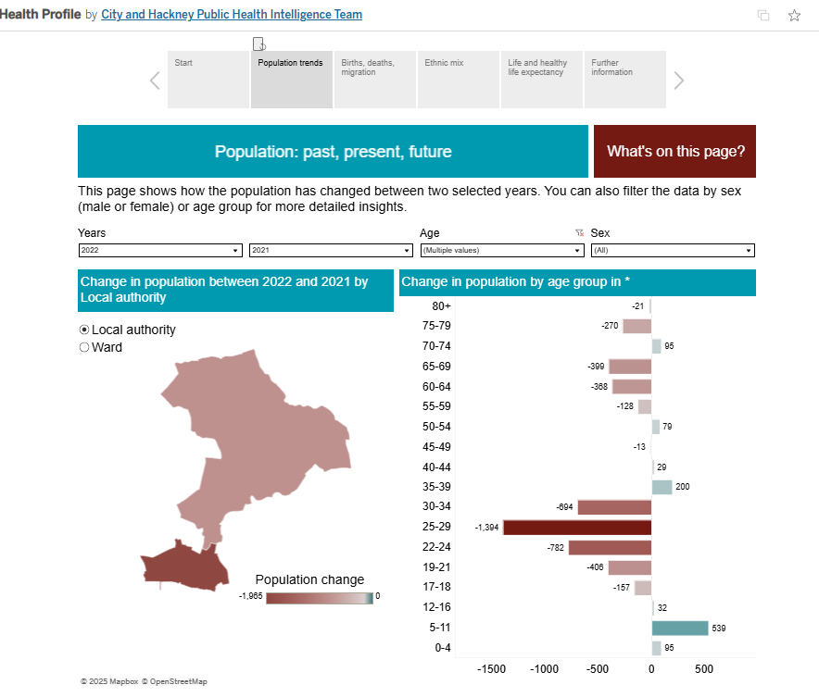
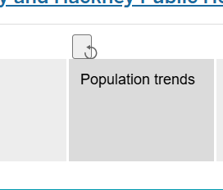
I want to reset the filters
Solution:
Click the grey square with the curved arrow to return the dashboard page to the default filters.
(see red circle on image to the right)

