Slide 1



How to guide -
Health in City and Hackney
18 September 2025

Slide 2
Contents
Quick start guide
Navigating the dashboard (jump to page specific instructions here)
Downloads
Sharing
Glossary
Troubleshooting

Slide 3

Quick Start Guide
Access the dashboard via this link: https://public.tableau.com/app/profile/phit.hackney/viz/Neighbourhoodandwardprofiles/Neighbourhoodandwardprofiles
Hover over the ‘What’s on this page?’ icon on the dashboard for information and instructions
Ask PHIT for help or share feedback: phit@hackney.gov.uk

Slide 4

Navigating the dashboard
Notes:
Need to say about downloading This Story

Slide 5
Dashboard pages
Health profiles - filters
Health profiles - visuals
Health profiles by age - filters
Health profiles by age - visuals
Health profiles by ethnicity - filters
Health profiles by ethnicity - visuals
Health profiles by deprivation - filters
Health profiles by deprivation - visuals
Detailed report of profiles - filters
Detailed report of profiles - visuals
Further information

Slide 6
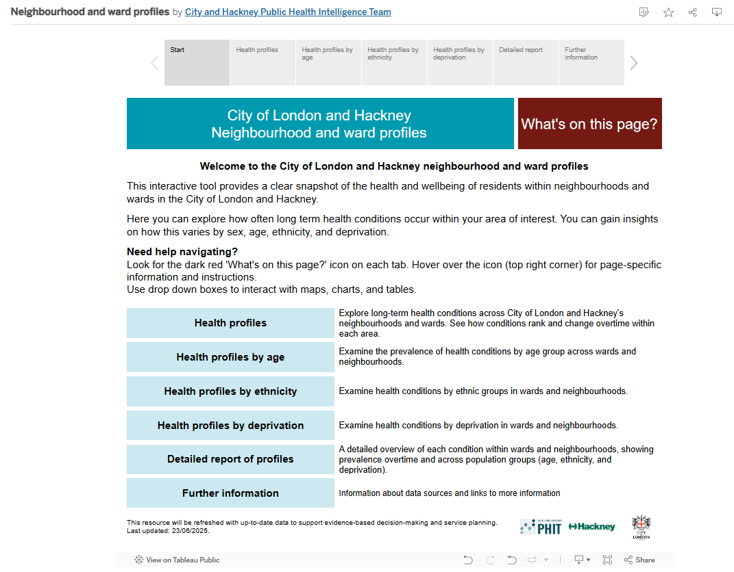
Start page
Click these grey boxes to move to the different pages
Click this link to view other PHIT dashboards
Hover over the ‘What’s on this page?’ icon - this is bring up a pop out box that explains each page
These light blue boxes correspond to the different dashboard pages and the grey boxes at the top of the page
Click the PHIT logo to be taken to the City and Hackney Public Health website

Slide 7
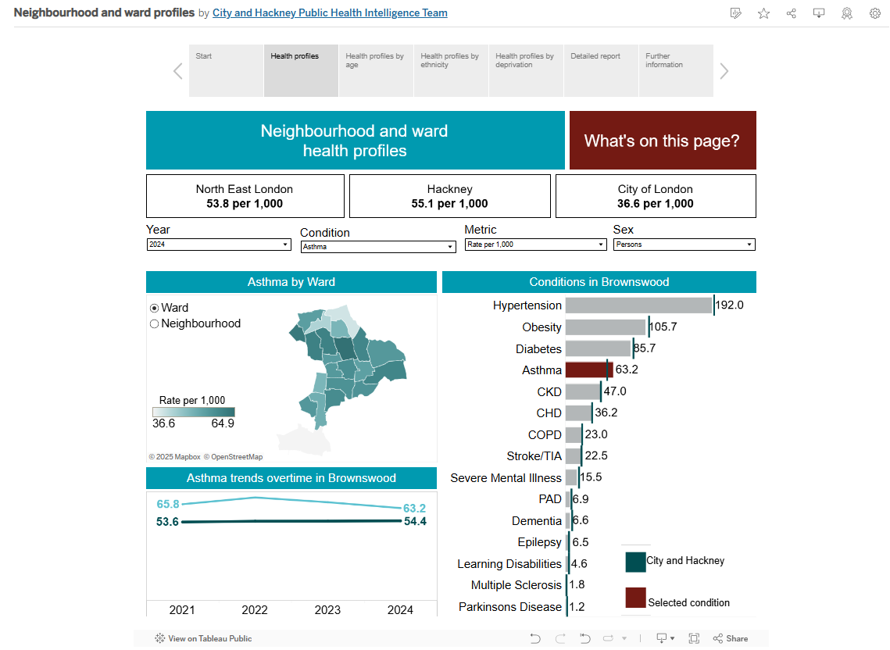
Health profiles - Filters
Hover over the ‘What’s on this page?’ icon - this is bring up a pop out box that explains each page
Drop down box to change the year
Drop down box to change the sex (persons, female, male)
Drop down box to change the long term health condition
Drop down box to change the metric (count, proportion, rate)
Select ward or neighbourhood to change the map breakdown
Select the ward/neighbourhood on the map you’re interested in to show data for this area

Slide 8
Health profiles - visuals
Hover over the ‘What’s on this page?’ icon - this is bring up a pop out box that explains each page
Hover over the North East London box to see ranking of boroughs by condition (e.g. Asthma)
Prevalence for selected condition in North East London, Hackney and City of London (e.g. Asthma)
Map shows prevalence of condition across wards/neighbourhoods
Bar chart ranking conditions in selected area (e.g. Brownswood)
Scale of prevalence - the darker the shade the higher the prevalence
Red bar represents selected condition
Line graph to show prevalence overtime for selected area (light blue) and City and Hackney (green)
Green line represents prevalence for City and Hackney

Slide 9
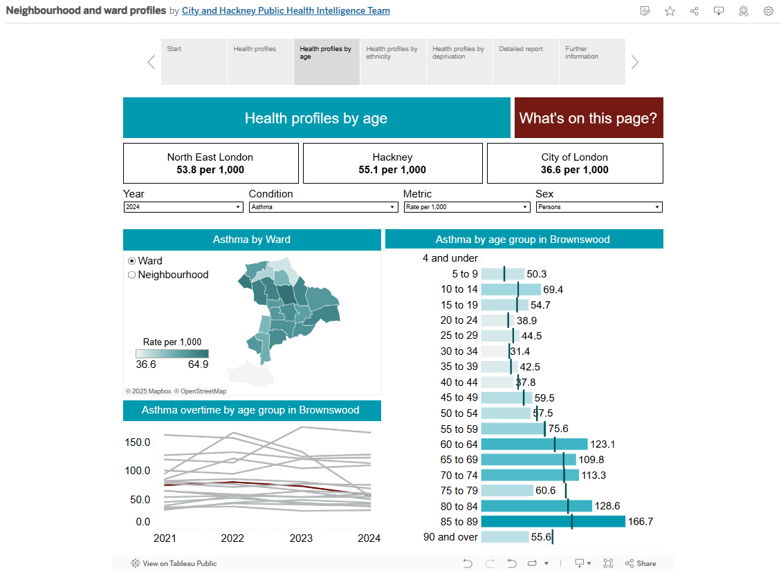
Health profiles by age - Filters
Hover over the ‘What’s on this page?’ icon - this is bring up a pop out box that explains each page
Drop down box to change the year
Drop down box to change the sex (persons, female, male)
Drop down box to change the long term health condition
Drop down box to change the metric (count, proportion, rate)
Select ward or neighbourhood to change the map breakdown
Select an age group on the bar chart to change the red line in the line graph
Select the ward/neighbourhood on the map you’re interested in to show data for this area

Slide 10
Health profiles by age - visuals
Hover over the ‘What’s on this page?’ icon - this is bring up a pop out box that explains each page
Hover over the North East London box to see ranking of boroughs by condition (e.g. Asthma)
Prevalence for selected condition in North East London, Hackney and City of London (e.g. Asthma)
Map shows prevalence of condition across wards/neighbourhoods
Bar chart shows prevalence by age group of condition in selected area (e.g. Brownswood)
Scale of prevalence - the darker the shade the higher the prevalence
Line graph to show prevalence overtime for age groups in selected area - the red line is the selected age group which can be changed by clicking on the bar chart
Green line represents prevalence for City and Hackney

Slide 11
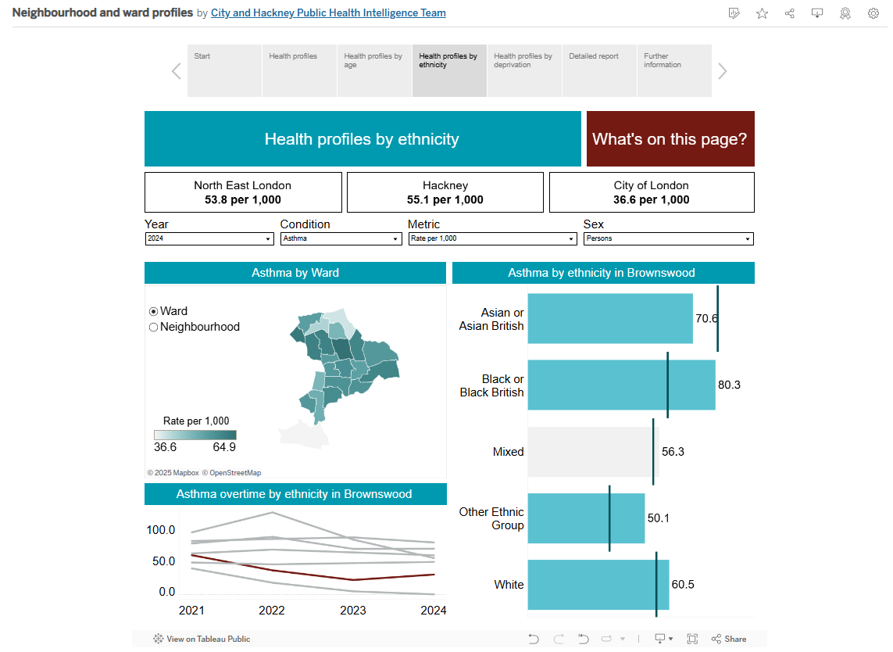
Health profiles by ethnicity - Filters
Hover over the ‘What’s on this page?’ icon - this is bring up a pop out box that explains each page
Drop down box to change the year
Drop down box to change the sex (persons, female, male)
Drop down box to change the long term health condition
Drop down box to change the metric (count, proportion, rate)
Select ward or neighbourhood to change the map breakdown
Select an ethnic group on the bar chart to change the red line in the line graph
Select the ward/neighbourhood on the map you’re interested in to show data for this area

Slide 12
Health profiles by ethnicity - visuals
Hover over the ‘What’s on this page?’ icon - this is bring up a pop out box that explains each page
Hover over the North East London box to see ranking of boroughs by condition (e.g. Asthma)
Prevalence for selected condition in North East London, Hackney and City of London (e.g. Asthma)
Map shows prevalence of condition across wards/neighbourhoods
Bar chart shows prevalence by ethnic group of condition in selected area (e.g. Brownswood)
Scale of prevalence - the darker the shade the higher the prevalence
Line graph to show prevalence overtime for ethnic groups in selected area - the red line is the selected ethnic group which can be changed by clicking on the bar chart
Green line represents prevalence for City and Hackney

Slide 13
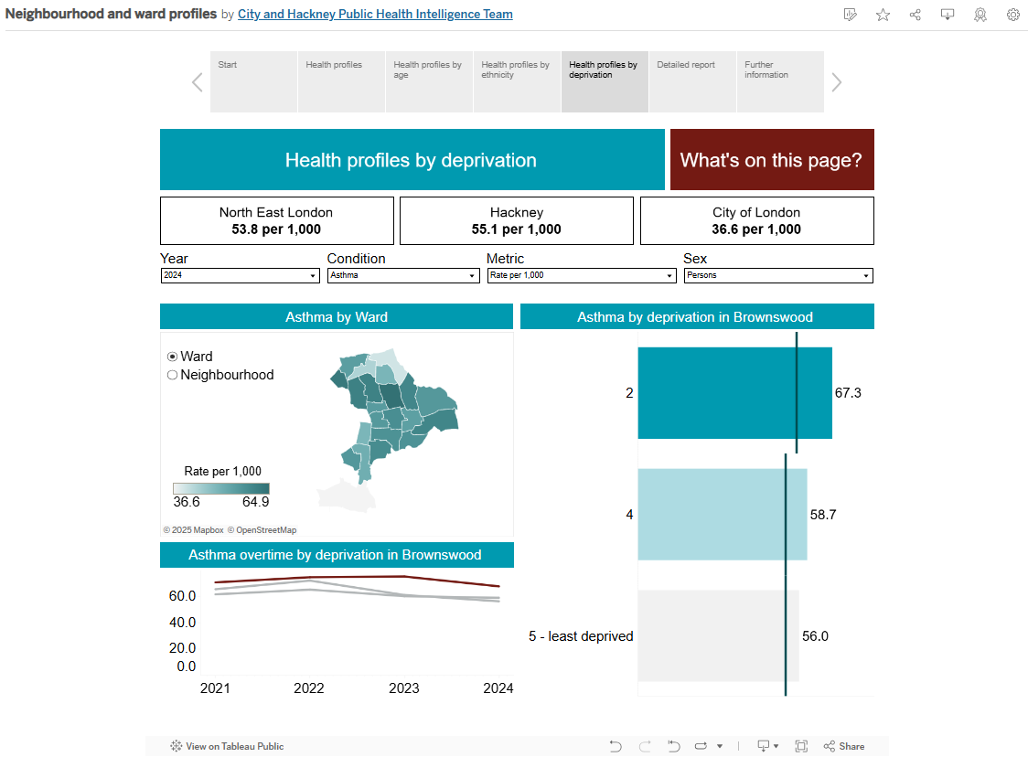
Health profiles by deprivation - Filters
Hover over the ‘What’s on this page?’ icon - this is bring up a pop out box that explains each page
Drop down box to change the year
Drop down box to change the sex (persons, female, male)
Drop down box to change the long term health condition
Drop down box to change the metric (count, proportion, rate)
Select ward or neighbourhood to change the map breakdown
Select a deprivation quintile on the bar chart to change the red line in the line graph
Select the ward/neighbourhood on the map you’re interested in to show data for this area

Slide 14
Health profiles by deprivation - visuals
Hover over the ‘What’s on this page?’ icon - this is bring up a pop out box that explains each page
Hover over the North East London box to see ranking of boroughs by condition (e.g. Asthma)
Prevalence for selected condition in North East London, Hackney and City of London (e.g. Asthma)
Map shows prevalence of condition across wards/neighbourhoods
Bar chart shows prevalence by deprivation quintile of condition in selected area (e.g. Brownswood)
Scale of prevalence - the darker the shade the higher the prevalence
Line graph to show prevalence overtime by deprivation quintile in selected area - the red line is the selected deprivation quintile which can be changed by clicking on the bar chart
Green line represents prevalence for City and Hackney

Slide 15
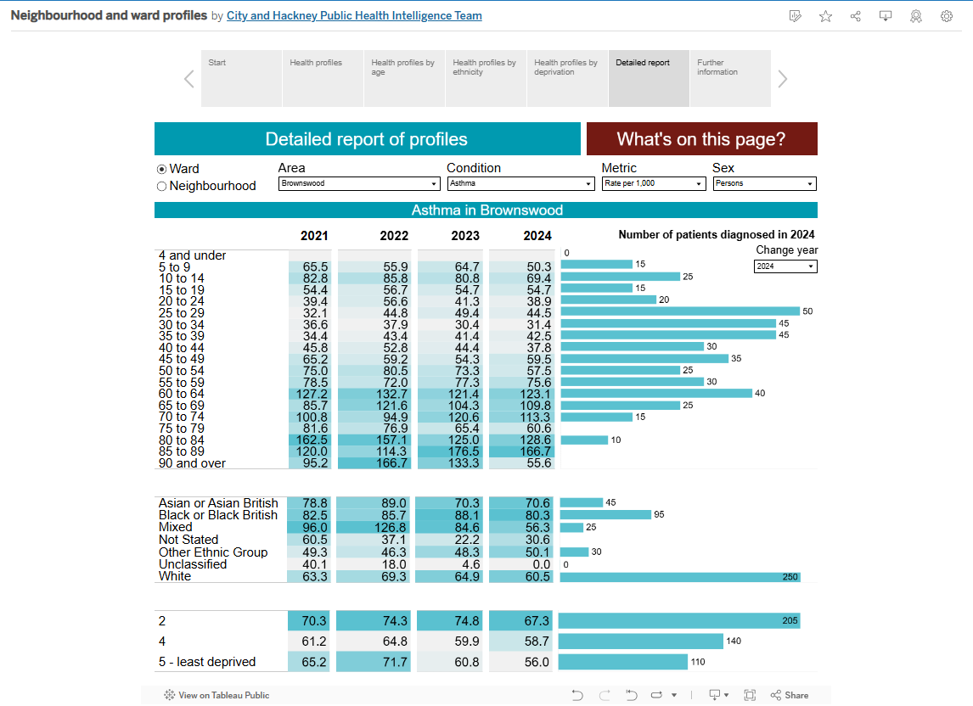
Detailed report of profiles - Filters
Hover over the ‘What’s on this page?’ icon - this is bring up a pop out box that explains each page
Drop down box to change the are (e.g. Brownswood)
Drop down box to change sex (person, female, male)
Select ward or neighbourhood to change the map breakdown
Drop down box to change the metric (count, proportion, rate)
Drop down box to change the long term health condition
Drop down box to change year of the bar charts

Slide 16
Detailed report of profiles - visuals
Hover over the ‘What’s on this page?’ icon - this is bring up a pop out box that explains each page
Heat map by age group - darker the shade of blue the higher the prevalence of the condition (e.g. asthma)
This blue banner shows the condition and area selected
Heat map by ethnic group - darker the shade of blue the higher the prevalence of the condition (e.g. asthma)
Number of patients diagnosed with condition in year by age group
Number of patients diagnosed with condition in year by ethnic group
Heat map by deprivation - darker the shade of blue the higher the prevalence of the condition (e.g. asthma)
Number of patients diagnosed with condition in year by deprivation

Slide 17
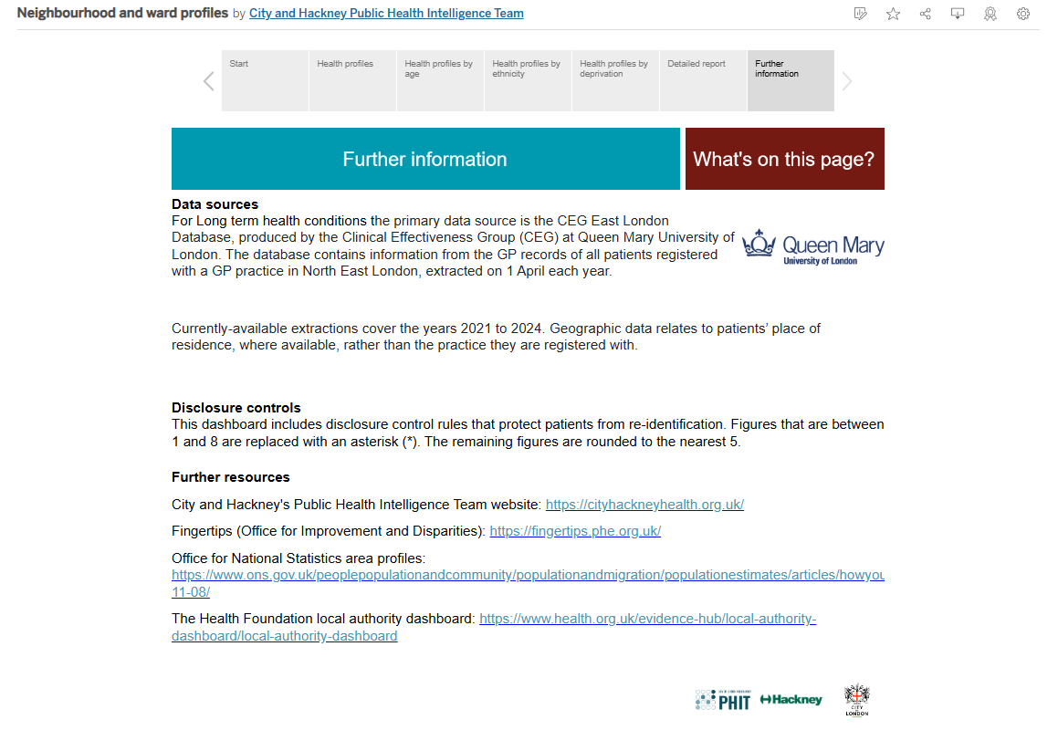
Further information
Hover over the ‘What’s on this page?’ icon - this is bring up a pop out box that explains each page
Information on data sources
Click on the Queen Mary Logo to be taken to the East London Database website for more information
Information on disclosure controls
Further resources for related data
Click the PHIT logo to be taken to the City and Hackney Public Health website

Slide 18
Downloads
Notes:
Need to say about downloading This Story

Slide 19
Downloads
You can download the dashboard page in the following formats:
Image (png)
Pdf
Powerpoint (ppt)

Slide 20

Downloads - step 1
Select the icon at the top right hand corner of the dashboard
Icon is a grey rectangle with an arrow pointing downwards
(see red circle in image for location)

Slide 21
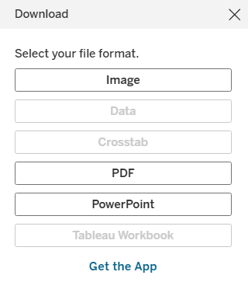
Downloads - step 2
A pop up box will appear in the middle of your screen (see image to the right)
Here you select the file format - see next slides for details on each option

Slide 22
Downloads - downloading an image
Selecting image will automatically download the dashboard page you’re viewing - this will appear in your downloads.
To do this, click the image button

Slide 23
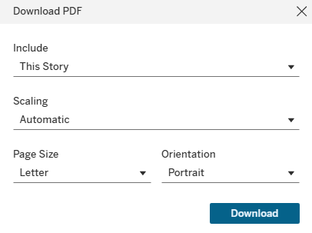
Downloads - downloading a PDF
Select PDF to download a PDF of the entire dashboard.
This will open a second pop up box.
Make sure the Include dropdown is always ‘This Story’.
Other fields can be changed but we recommend leaving these as the default options.
To download, click the blue download box

Slide 24
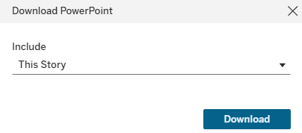
Downloads - downloading a powerpoint
Select PowerPoint to download a powerpoint (slide pack) of the entire dashboard.
This will open a second pop up box.
Make sure the Include dropdown is always ‘This Story’.
To download, click the blue download box

Slide 25
Sharing
Notes:
Need to say about downloading This Story

Slide 26

Sharing - step 1
Select the icon at the top right hand corner of the dashboard
Icon is three grey circles connected by grey lines
(see red circle in image for location)

Slide 27
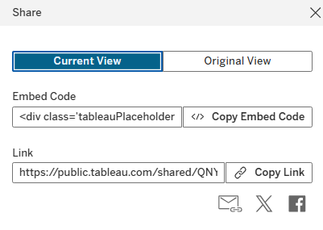
Sharing - step 2
A pop up box will appear in the middle of your screen (see image below)
Selecting Current View will share the dashboard in the state you’re viewing
Selecting Original View will share the dashboard in the default settings
Select Copy Link - you can then paste in emails/messages etc to share

Slide 28
Glossary
Notes:
Need to say about downloading This Story

Slide 29
Glossary - general (1)
Term | Definition
Condition (or long term health condition) | This is a health problem that requires ongoing management over a period of years or decades and is one that cannot currently be cured but can be controlled with the use of medication and/or other therapies.
Deprivation | Deprivation has been defined using the English Indices of Deprivation, commonly known as the Index of Multiple Deprivation (IMD). This is the official measure of relative deprivation for Lower Super Output Areas (LSOAs) in England. In this dashboard, 2021 LSOA-based IMD2019 quintiles within the City of London and Hackney as at April 2023 have been used. Quintiles are calculated by ranking the LSOAs in City and Hackney from most deprived to least deprived and dividing them into 5 equal groups. These range from the most deprived 20% of neighbourhoods nationally to the least deprived 20% of neighbourhoods nationally.

Slide 30
Glossary - general (2)
Term | Definition
Prevalence | A measure of the frequency of a disease or health condition in a population at a particular point in time. Commonly used metrics in public health include counts, proportions and rates. See glossary of metrics for more detail on counts, proportions and rates.

Slide 31
Glossary - metrics (1)
Term | Definition
Count (or number of people with condition) | The number of people who are on the [condition name] register within primary care that reside in the City of London and Hackney and are registered within a GP practice in North East London ICB.
Proportion | This metric calculates the percentage of people who have [condition name] within the specific group of patients who meet two criteria: They reside in the City of London and Hackney. They are registered with a GP practice within the North East London (NEL) Integrated Care Board (ICB). Proportion is calculated as number of people with the condition / total number of people that reside in the City of London and Hackney and are registered within a GP practice in North East London ICB) * 100

Slide 32
Glossary - metrics (2)
Term | Definition
Rate per 1,000 | This is the direct age-standardised rate. This is the most comprehensive way of comparing the disease prevalence of two or more populations, such as comparing two wards within the City and Hackney, as the different population structures are taken in to account. The direct method is where the age-specific rates of the population are applied to the age structure of the European Standard Population. This gives the overall rate that would have occurred in the subject population if it had the standard age-profile.
For more information on counts, proportions and rates please see the APHO Technical Briefing 3 – Commonly used public health statistics and their confidence intervals

Slide 33
Glossary - geography
Term | Definition
Neighbourhood | In this dashboard, neighbourhoods refer to Primary Care Networks (PCNs). A PCN is where GP practices work together with community, mental health, social care, pharmacy, hospital and voluntary services in their local areas. The London Borough of Hackney and the City of London form a single NHS health and care system, made up of eight Primary Care Networks (PCNs). Each area has its own characteristics and health needs.
Ward | Electoral wards and divisions are the key building blocks of UK administrative geography. They are the spatial units used to elect local government councillors in metropolitan and non-metropolitan districts, unitary authorities and the London boroughs in England. There are multiple wards in the City of London. In this dashboard, these have been combined to create one area for the City of London.

Slide 34
Glossary - conditions (1)
Term | Definition
Asthma | Patients aged 6 yrs and older with asthma, excluding those who have been prescribed no asthma-related drugs in the previous twelve months, as recorded on practice disease registers from all registered patients aged 6 yrs and older. From Quality outcomes framework.
Cancer | Patients of all ages with a diagnosis of cancer excluding non-melanotic skin cancers diagnosed on or after 1 April 2003. From the Quality outcomes framework.
Coronary heart disease | Patients of all ages with coronary heart disease (CHD), as recorded on practice disease register. From Quality outcomes framework.
Chronic kidney disease | Patients aged 18 years and over with chronic kidney disease (CKD) with classification of categories G3a to G5, as recorded on practice disease registers. From Quality outcomes framework.

Slide 35
Glossary - conditions (2)
Term | Definition
Chronic obstructive pulmonary disease | Patients of all ages with COPD, as recorded on practice disease registers. From Quality outcomes framework.
Dementia | Patients with dementia recorded on GP practice registers From Quality outcomes framework.
Diabetes | Patients aged 17+ yrs with diabetes mellitus. From Quality outcomes framework.
Depression | Patients aged 18 or over with a new diagnosis of depression in the preceding 1 April to 31 March, who have been reviewed not earlier than 10 days after and not later than 56 days after the date of diagnosis. From Quality outcomes framework.
Epilepsy | Patients aged 18 and over who are receiving drug treatment for epilepsy. From Quality outcomes framework.

Slide 36
Glossary - conditions (3)
Term | Definition
Heart failure | Patients of all ages who have been diagnosed with heart failure. From Quality outcomes framework.
Hypertension | The number of patients with established hypertension, as recorded on practice disease registers. From Quality outcomes framework.
Learning disabilities | Patients with learning disabilities, as recorded on the practice disease register. From Quality outcomes framework.
Multiple sclerosis | Patients with MS, as recorded on the practice disease register. From Quality outcomes framework.
Obesity | Patients aged 18 or over living with obesity, as recorded in the previous 12 months on the practice disease register. Obesity is defined as a BMI greater than or equal to 30 kg/m2 or greater than or equal to 27.5 kg/m2 for patients with a South Asian, Chinese, other Asian, Middle Eastern, Black African or African-Caribbean family background. From Quality outcomes framework.

Slide 37
Glossary - conditions (4)
Term | Definition
Obesity | Patients aged 18 or over living with obesity, as recorded in the previous 12 months on the practice disease register. Obesity is defined as a BMI greater than or equal to 30 kg/m2 or greater than or equal to 27.5 kg/m2 for patients with a South Asian, Chinese, other Asian, Middle Eastern, Black African or African-Caribbean family background. From Quality outcomes framework.
Osteoporosis | Patients aged 50 years and over on the Osteoporosis disease registers. Osteoporosis is a disease characterised by low bone mass and structural deterioration of bone tissue. Quality outcomes framework.
Non-diabetic hyperglycaemia | Patients aged 18 years and over who have been diagnosed with Non-Diabetic Hyperglycaemia and have not been diagnosed with diabetes. Also known as prediabetes. From Quality outcomes framework.
Peripheral artery disease | Patients of all ages with peripheral artery disease, as recorded on practice disease registers. From Quality outcomes framework.

Slide 38
Glossary - conditions (5)
Term | Definition
Parkinson’s disease | Patients of all ages with Parkinson’s disease, as recorded on practice disease registers. From Quality outcomes framework.
Palliative care | Patients of all ages as recorded on practice disease register. Palliative or end of life care is the active, holistic care of patients with advanced, progressive disease and those important to them. From Quality outcomes framework.
Severe mental illness (SMI) | Patients of all ages with SMI as recorded on practise disease registers. SMI is defined within QoF as referring to people with ‘a diagnosis of schizophrenia, bipolar affective disorder or who have experienced an episode of non-organic psychosis’. From Quality outcomes framework.
Stroke/transient ischemic attack | Patients of all ages with stroke or transient ischaemic attack (TIA), as recorded on practice disease registers. From Quality outcomes framework.

Slide 39
Glossary - conditions (6)
Term | Definition
Rheumatoid Arthritis | Patients aged 16 years and over who are recorded on the Rheumatoid Arthritis disease register. Rheumatoid arthritis (RA) is a chronic, disabling auto-immune disease characterised by inflammation in the peripheral joints. From Quality outcomes framework.

Slide 40
Troubleshooting
Notes:
Need to say about downloading This Story

Slide 41
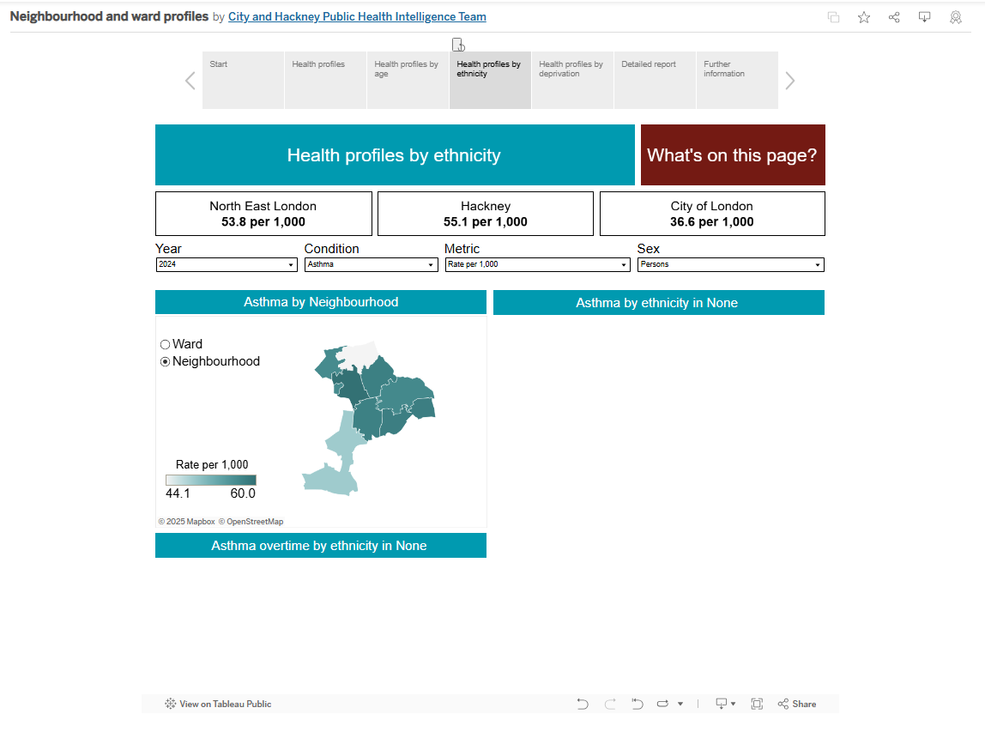
The bar chart and line chart are missing
Solution:
Select an area on the map.
The bar and line charts will reappear displaying information for the area you selected.

Slide 42
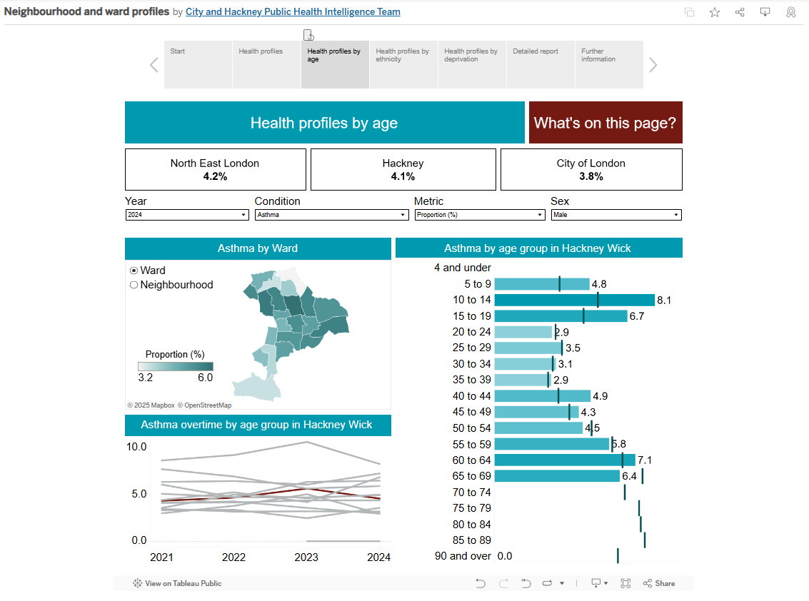
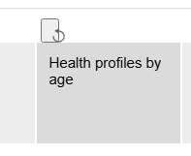
I want to reset the filters
Solution:
Click the grey square with the curved arrow to return the dashboard page to the default filters.
(see red circle on image to the right)

